Slide 1

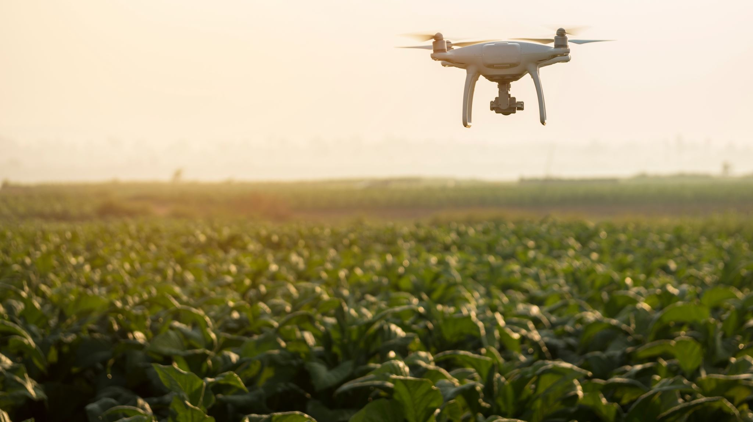
ExtinguishAI: AI-Powered Drone Surveillance for Wildfire Prevention
Innovating for a safer and more sustainable forest future

Slide 2
Team Introduction
Maheen – [Project Designer]
Sarah – [Project Developer]
Hannah – [Data Analyst]
Pralay – [Project Manager]

Slide 3
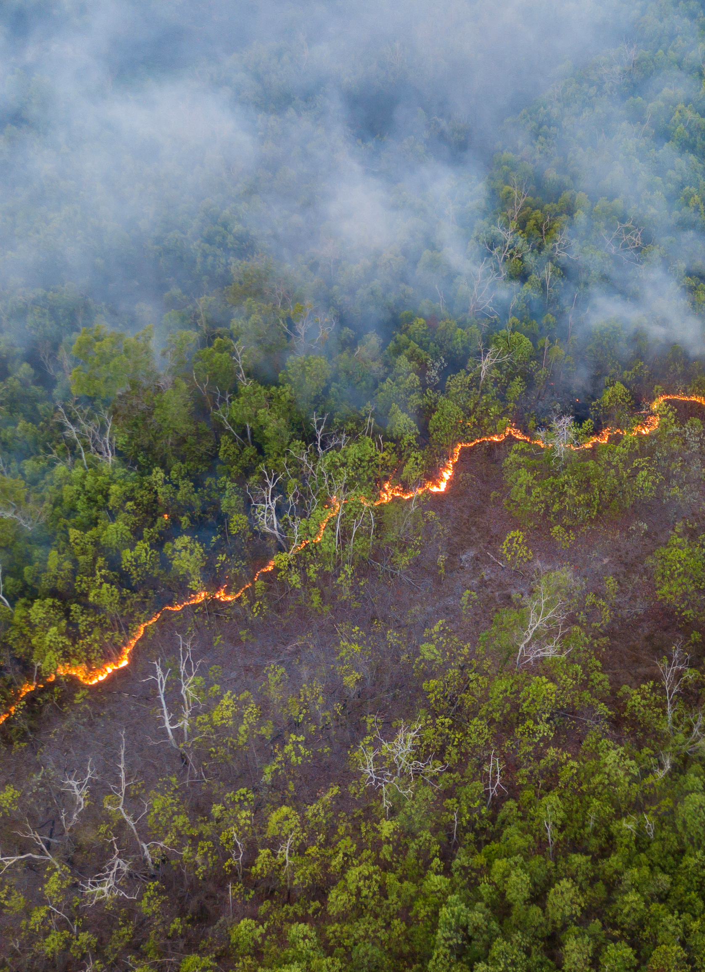
The Growing Threat of Wildfires
Wildfires are more destructive than ever due to Climate Change
In 2024 alone, 8.92 Million acres of land was burnt by wildfires
Loss of biodiversity
Destroyed ecosystems and wildlife habitats
https://www.statista.com/statistics/203990/area-of-acres-burnt-due-to-wildland-fires-in-the-us/
Notes:
8.92 million acres: https://www.statista.com/statistics/203990/area-of-acres-burnt-due-to-wildland-fires-in-the-us/

Slide 4



Problems With the Current Solutions
High Costs:
Firefighting efforts are incredibly expensive and labor-intensive
Delayed Detection:
Cameras and satellites only alert, without any direct response system
Limited Prevention:
Current solutions focus on fighting fires rather than stopping them early

Slide 5
Introducing ExtinguishAI
AI- Powered drones will detect, analyze, and suppress wildfires
Use of AI, thermal imaging, and Starlink
Real time decision making with AI

Slide 6
Key Objectives
Early Detection: AI-driven thermal sensors can identify fires in the earliest stages.
Rapid Response: Autonomous drones deploy instantly
Sustainable: Solar-powered infrastructure will ensure uninterrupted operations.

Slide 7
Overview of Technological Approach
Autonomous Drone Navigation: AI-optimized routes ensure efficiency.
Fire Retardant Deployment: Targeted suppression prevents escalation.
AI-Powered Image Processing: Detects temperature anomalies.

Slide 8
How ExtinguishAI stands out
Will Combine detection, alerts, and suppression in one system.
Faster & more efficient than traditional firefighting.
Sustainable & scalable for long-term impact.

Slide 9
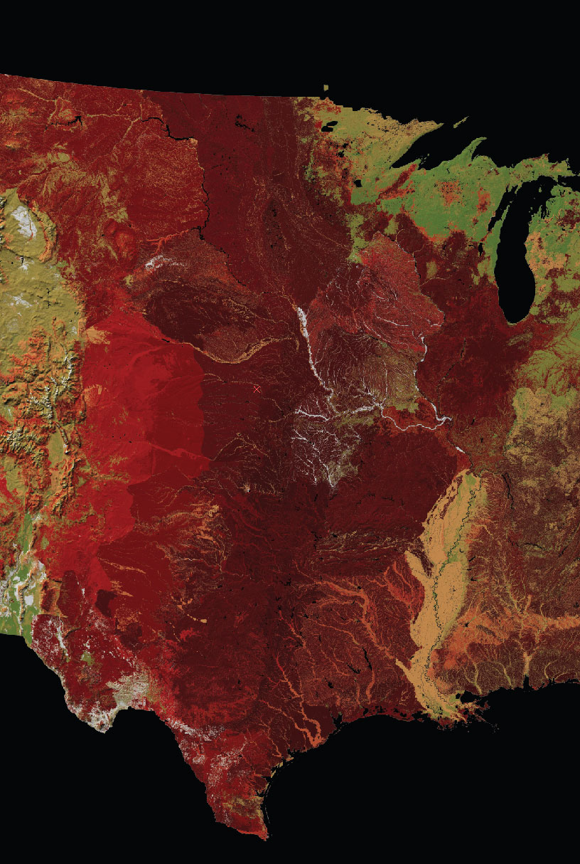
AI-Powered Fire Detection
Train learning models using historical wildfire data to recognize early fire indicators.
Ex: National Centers for Environmental Information
Combine thermal Imaging and computer vision data to enhance recognition of real threats or false alarms
Temperature differences
Heat Patterns
Movement
https://emlab.ucsb.edu/projects/bringing-historical-perspective-wildfires-california

Slide 10



Machine Learning for Predictive Analysis
To enable proactive drone deployment, AI models analyze for fire patterns using:
Wind speed:
High wind speeds determine spread of fires
Temperature:
High temperatures determine likelihood of fire outbreaks
Humidity:
Low humidity determines flammability of fuel

Slide 11
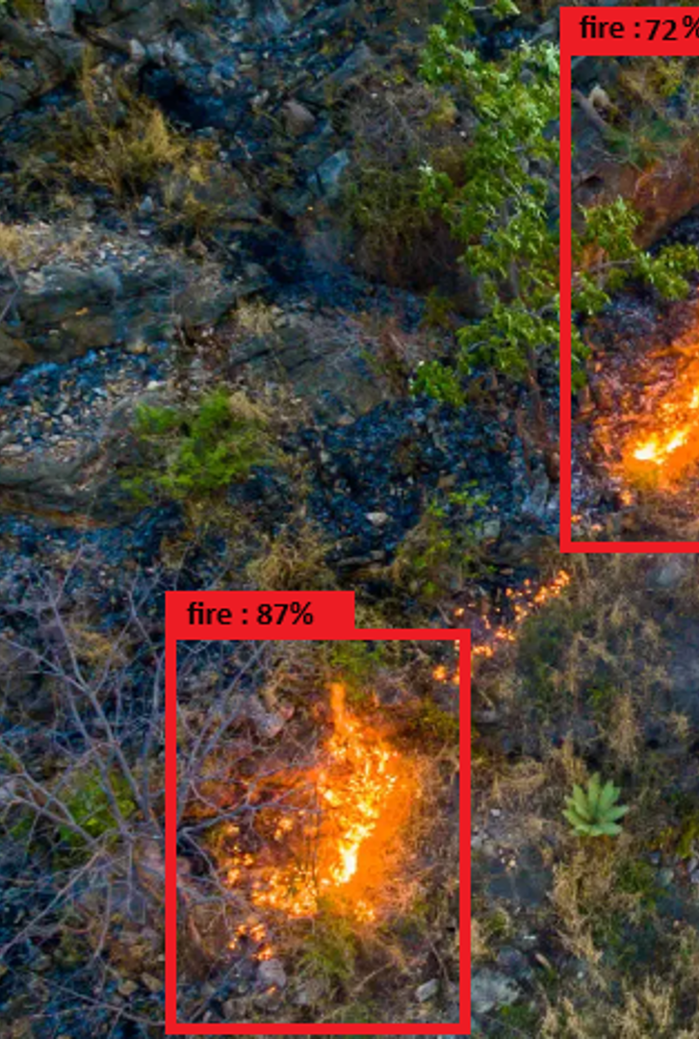
Computer Vision for Fire Identification
Drones will use object detection algorithms to differentiate threatening and non-threatening heat sources
Before flames are visible to satellites, AI drones will detect early-stage fire flickers and send alerts to local fire stations.

Slide 12

AI Model Training & Optimization
Refine AI models by feeding them new wildfire data, ensuring accurate and up-to-date fire prediction
Government databases: quarterly, annual
Weather/Climate: daily

Slide 13
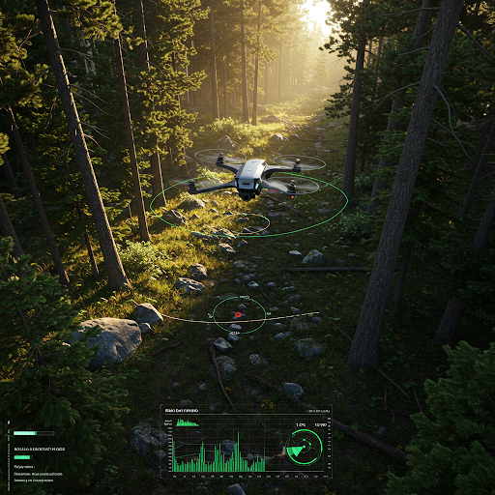
AI's Role in Autonomous Navigation
AI calculates optimal flight paths, avoiding obstacles and navigating rough terrains while ensuring efficient wildfire tracking.
Sensor data
Wind speed and direction
Machine Learning
Computer vision (Object detection)

Slide 14
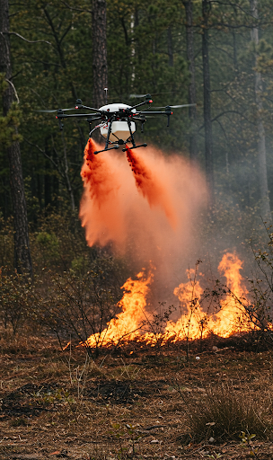
AI-Driven Decision Making
Automated Response:
Determines the best suppression method
Fire retardant vs. Emergency alert
Adaptive Learning:
AI improves response strategies based on past incidents.

Slide 15
Real-World AI Application Potential
Search-and-Rescue
Deforestation Monitoring
Agricultural Fire Prevention

Slide 16
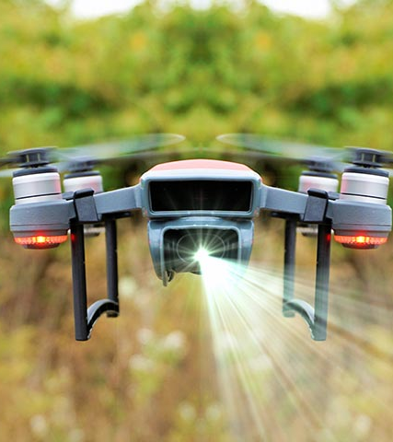
Drone Hardware & Sensor Integration
Our drones feature high-resolution thermal cameras, LiDAR sensors, and autonomous navigation modules.
These Smart Cameras Spot Wildfires Before They Spread - WSJ

Slide 17
Fire Retardant Deployment System
Drones carry and release fire retardants at the source, preventing further spread. AI determines optimal drop locations.
PowerPoint Presentation (nasa.gov)

Slide 18
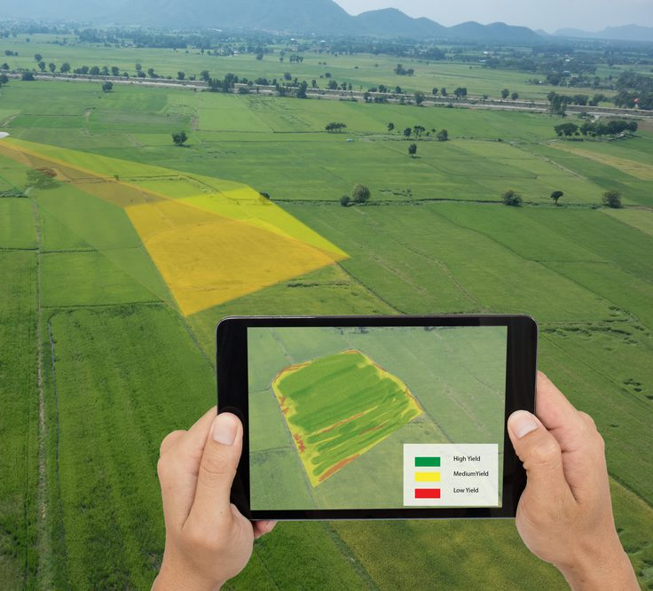
Autonomous Flight & Route Optimization
Drones autonomously patrol pre-defined routes but can adjust based on AI risk assessments.

Slide 19
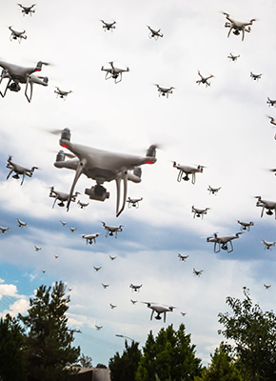
Swarm Drone Coordination
Multiple drones work together, covering large forest areas efficiently through AI-controlled formations.

Slide 20
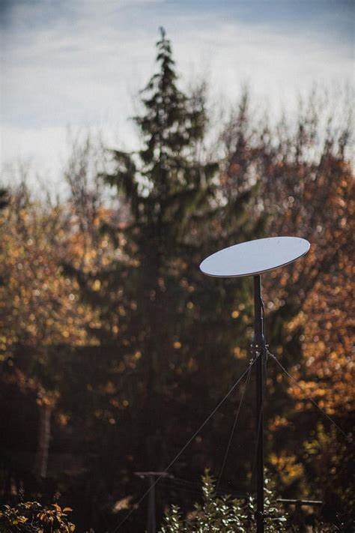
Starlink-Powered Connectivity
Drones remain connected even in remote areas through Starlink, ensuring real-time fire monitoring and response.

Slide 21
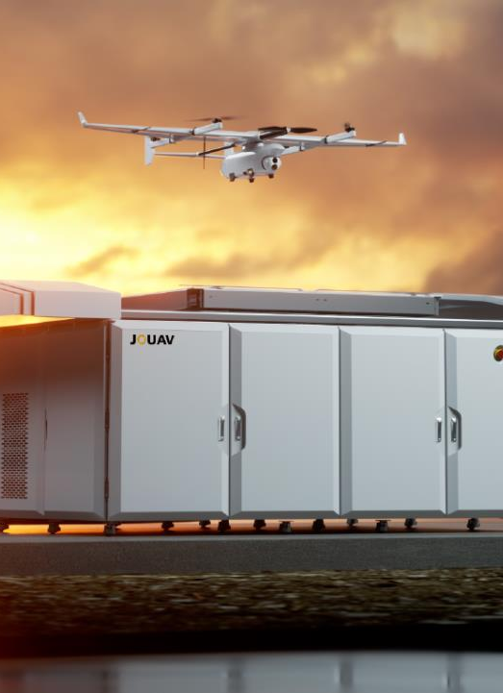
Secure Drone Storage & Charging
Weatherproof storage stations house drones, equipped with solar panels and backup batteries for continuous operation.

Slide 22

Future Drone Enhancements
We plan to integrate heavier payloads, AI-driven wind pattern analysis, and advanced fire suppression chemicals.

Slide 23
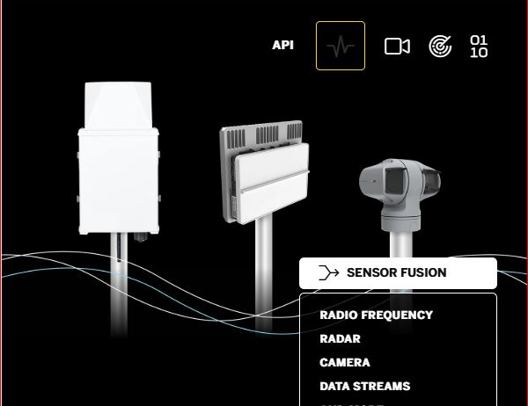
ExtinguishAI Mobile App
Instant Alerts:
Users would receive immediate notifications about critical events.
Real-Time Monitoring:
This would enable users to oversee drone operations in real-time.
Manual Control:
An app would allow for direct drone control.
Notes:
We will also create a mobile app for users to use to monitor all drone activity. This will streamline all drone processes. You will be able to receive alerts, and manual control drones through our AI- powered mobile app

Slide 24
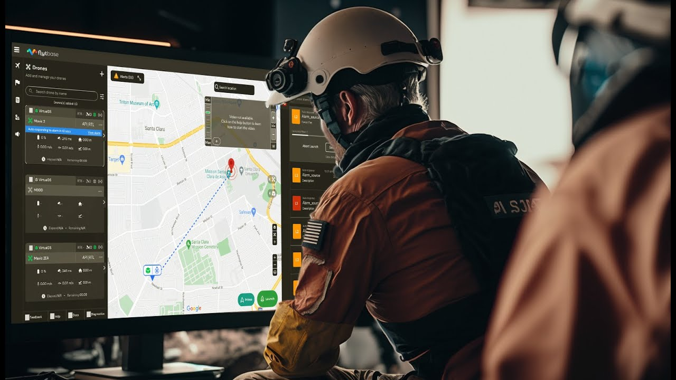
Real-Time Emergency Notifications
Automated Alerts:
AI systems can automatically notify fire departments.
Live Drone Footage:
Real-time visuals provide critical information
Improved Coordination:
Enhanced communication leads to more efficient emergency responses.
https://www.theguardian.com/world/article/2024/aug/15/how-ai-is-revolutionising-how-firefighters-tackle-blazes-and-saving-lives?utm_source=chatgpt.com
ThePhoto by PhotoAuthor is licensed under CCYYSA.
Notes:
Our drones will be connected to allow for real time emergency notifications. Fire departments and other law enforcement will be able to receive automatic alerts with drone footage, allowing them to act immediately. This will cut down in their response times and provide more efficient services.

Slide 25

Predictive Analytics Dashboard
The system would utilize a heat map of high-risk areas, helping forestry managers take preventive measures.
Risk Visualization: Heat maps identify areas susceptible to wildfires
Data Integration: We would combine satellite imagery and environmental data
Proactive Management: Forestry managers can implement measures in high-risk zones.
https://today.usc.edu/using-ai-to-predict-wildfires/
Notes:
With the data provided by the drones we will be able to maintain dashboards with predictive analytics. Utilizing this will allow us to mitigate as many fires as possible

Slide 26

Cloud-Based AI Data Processing
26
Real-Time Processing:
Cloud computing allows immediate analysis of incoming data.
Scalability:
Cloud infrastructure can handle large datasets, accommodating extensive monitoring systems.
Accessibility:
Authorized personnel can access data from any location.

Slide 27





AI-Optimized System Maintenance
Self-Diagnostics: Drones equipped with AI can assess their operational status.
Predictive Maintenance: Anticipating maintenance needs prevents unexpected breakdowns.
Operational Efficiency: Automated maintenance processes reduce downtime and manual inspection requirements.
Drones perform self-diagnostics and alert operators when repairs are needed.

Slide 28

Cybersecurity & Data Protection
Data Encryption: Protects sensitive information from unauthorized access.
Secure Communication: Ensures data integrity during transmission between drones and control systems.
Compliance: Adheres to industry standards and regulations for data protection.
Our encrypted system ensures data security, preventing unauthorized access.

Slide 29

Future System Expansion
Blockchain Integration: Provides transparent and immutable records of incidents.
Expanded Monitoring: Utilizing AI to monitor other environmental factors.
Innovative Solutions: Incorporating advanced technologies positions the system at the forefront of wildfire prevention and environmental conservation.

Slide 30
Summary & Call to Action
ExtinguishAI is more than just a fire detection system; it’s a complete AI-powered prevention and suppression solution.
Our technology-driven approach ensures early intervention, rapid response, and sustainable operations, setting a new standard for wildfire prevention.
Notes:
When disasters strike, AI drones become critical tools for first responders. They can quickly search large areas to locate survivors, assess damage, identify hazards, and guide rescue teams. For example, thermal imaging helps find people trapped in rubble or lost in remote terrain. Drones can also deliver emergency supplies to cut-off areas. This rapid aerial response capability saves precious time when minutes matter most.

Slide 31
Thank You!
We appreciate your time and interest in ExtinguishAI.
Together, we can make a difference in wildfire prevention.
Innovating for a safer and more sustainable future!
Questions?
We’d love to hear your thoughts!

Slide 32
Q&A Discussion
Cost Analysis
LA Fire Damage Cost
Existing Technology vs our Technology
Fire Detection Process

Slide 33
Estimated Cost of ExtinguishAI 6-Drone System
Component | Cost (USD) | Details
High-Range Drone Unit (per drone) | $51,500 | Includes extended-range battery, high-resolution cameras, AI system, and fire-retardant system.
Drone Storage & Charging System | $47,500 | Weatherproof storage unit, large-scale solar panels, automated charging docks.
AI Software & Monitoring System | $43,000 | Fire detection, navigation software, cloud processing, predictive analytics.
Connectivity & Network Infrastructure | $17,500 | Starlink satellite connectivity, cloud storage, communication relays.
Deployment & Maintenance (Year 1) | $31,000 | Setup, routine maintenance, software updates, spare parts.
Total for Year 1 | $448,000 | Total cost for the 6-Drone System covering 2.36 million square miles of area.
https://docs.google.com/document/d/1lfZhAYJBpwgjVOGEevkY_AxDA8sVltEH/edit?usp=sharing&ouid=106539882794568680204&rtpof=true&sd=true

Slide 34
Comparison with UCSD ALERTCalifornia AI Cameras
Criteria | ExtinguishAI (6-Drone System) | UCSD ALERTCalifornia Camera Network
Cost (1st Year) | $448,000 | $20 million - $50 million
Coverage Area | 2.36 million square miles per day | Fixed camera locations, limited coverage
Deployment Time | Quick, deployable anywhere | Requires installation of infrastructure
Maintenance Costs | $31,000 annually | Ongoing, millions per year
Functionality | Active fire detection & suppression | Passive surveillance with cameras only
Home - ALERTCalifornia
Back to Q&A
CALFIRE, UC San Diego Get $10.4M Boost for Wildfire System (govtech.com)

Slide 35
Total Damages and costs from the most destructive 2025 LA fires
Name of fire (covering the larger fires) | Date fire started | Total acres burnt | Date fire was contained | Number of Structures Destroyed | Economic Damages
The Palisades Fires | Jan 7th | 23,000 | Jan 31st | 6,837
The Eaton Fires | Jan 7th | 14,021 | Jan 31st | 9,414
Combined damages of $28 Billion - $53.8 Billion
https://www.fire.ca.gov/incidents/2025
https://www.dailynews.com/2025/02/27/palisades-and-eaton-wildfires-caused-up-to-53-8-billion-in-property-damage-study-finds/
Back to Q&A

Slide 36
Existing Technologies vs. Our AI Technologies
ExtinguishAI Potential Software Technologies | NASA's FireSense Software Technologies | UCSD ALERTCalifornia Software Technologies
AI mobile app | AI drone swarms | AI systems – Real time video feeds
Cloud based AI data processing | AI high resolution risk maps | AI Automated Alerts & Early Warning System
Blockchain integration | AI machine learning to forecast | AI Smoke and Fire Detection
AI optimized maintenance | AI Electrical Fault Detection | Crowdsourced & Human-in-the-Loop AI Training
 |  | AI-Powered Fire Spread Prediction
Our proposals are feasible due to the existence of projects which demonstrate the potential of advanced AI-driven wildfire detection and monitoring systems.
https://esto.nasa.gov/firesense2022final/
https://today.ucsd.edu/story/alertcalifornia-and-cal-fires-fire-detection-ai-program-named-one-of-times-best-inventions-of-2023
Back to Q&A

Slide 37
Fire Detection Processes
Criteria | ExtinguishAI Fire Detection Potential | NASA FireSense Fire Detection Programming | UCSD ALERTCalifornia Fire Detection Programming
Detection Method | Thermal Imaging, Computer Vision via drone; Satellite Connectivity | Airborne; Satellite Observation | High-Definition, 360 Pan-Tilt-Zoom, Near-Infrared via camera
Speed of Detection | Immediate upon real-time patrol | Within 3 hours, some real-time | 24 hour, Real-time, 360-degree sweep every 2 minutes
Accuracy in Identifying Fires | Object Detection: Heat sources; Machine Learning; Environmental Factors; Historical Data | Visible/Infrared/Thermal Images; Environmental Factors; Historical Data | Human-Monitoring for Confirmation; Historical Data
Response Method | Instant Fire station Alert, Instant Fire Retardant Deployment | Aids in Location | Alert Watchstanders
Ability to Detect Early-Stage Fires | Fire Flickers, Small Heat Source | Simply Predicts Areas of Fire | Smoke
https://cce.nasa.gov/firesense/airborne_campaigns.html
https://today.ucsd.edu/story/alert-california
Back to Q&A

